Slide 1
Wearable GPS Tracking System
Coronel, Sheena Christine
Hibaler, Jose Ricardo Milandro
Rubianes, May Rose
Santos, Nasia

Slide 2
Project Objectives
To be able to eliminate the stress and tension brought on by the constant need to monitor the current location of a patient suffering from dementia and the likes

Slide 3
Purpose
To be able to be notified whenever the patient leaves the premises
To be able to track the patient’s current location and be provided with a list of emergency contact numbers that can be called in times of emergency

Slide 4
Target Users/Beneficiaries
Patient suffering from Alzheimer’s disease
Guardian/Relative of the patient

Slide 5
Limitations

Slide 6
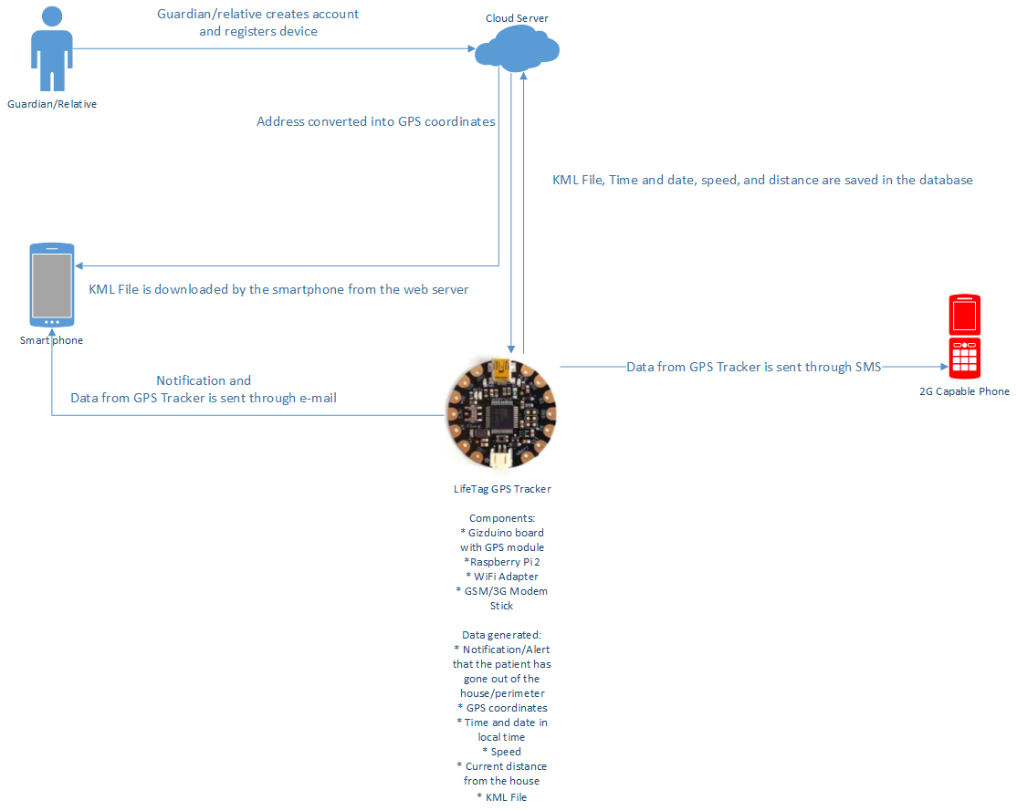
DIAGRAMS ● Systems Configuration

Slide 7
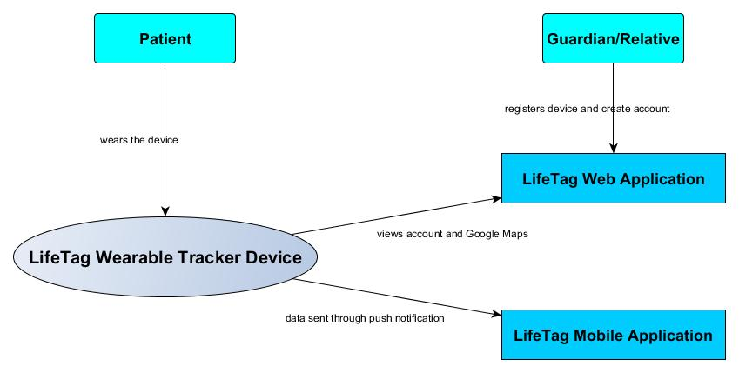
● Context Flow Diagram

Slide 8
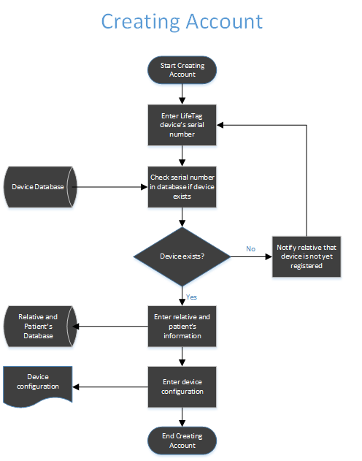
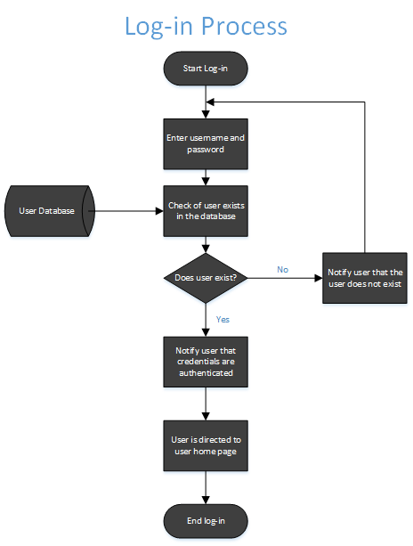
● Process Flow

Slide 9
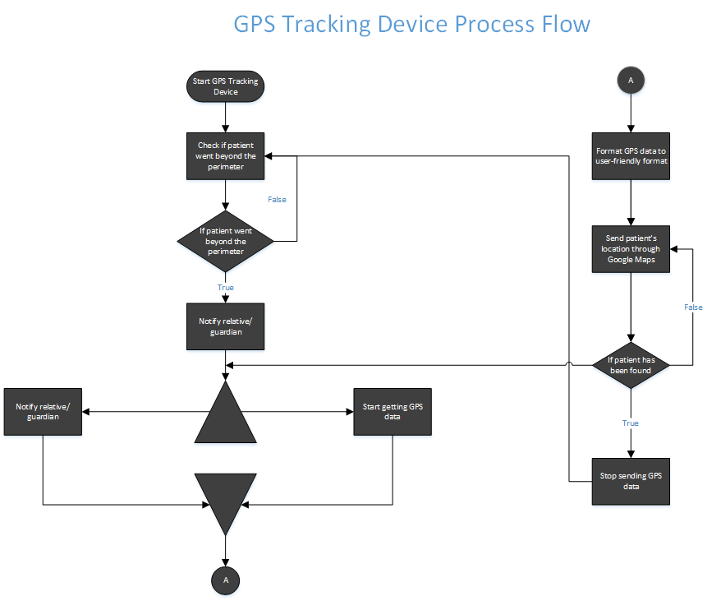

Slide 10
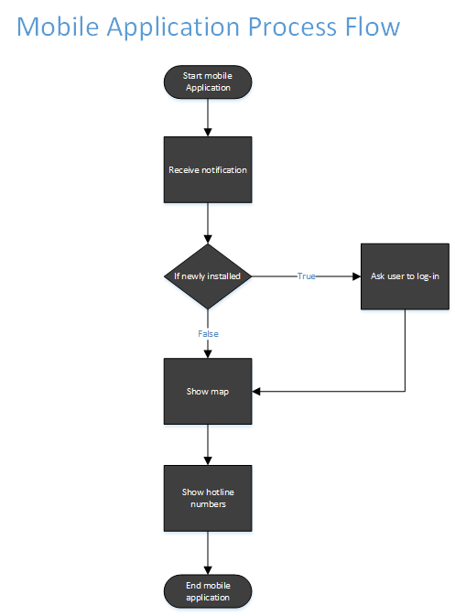

Slide 11
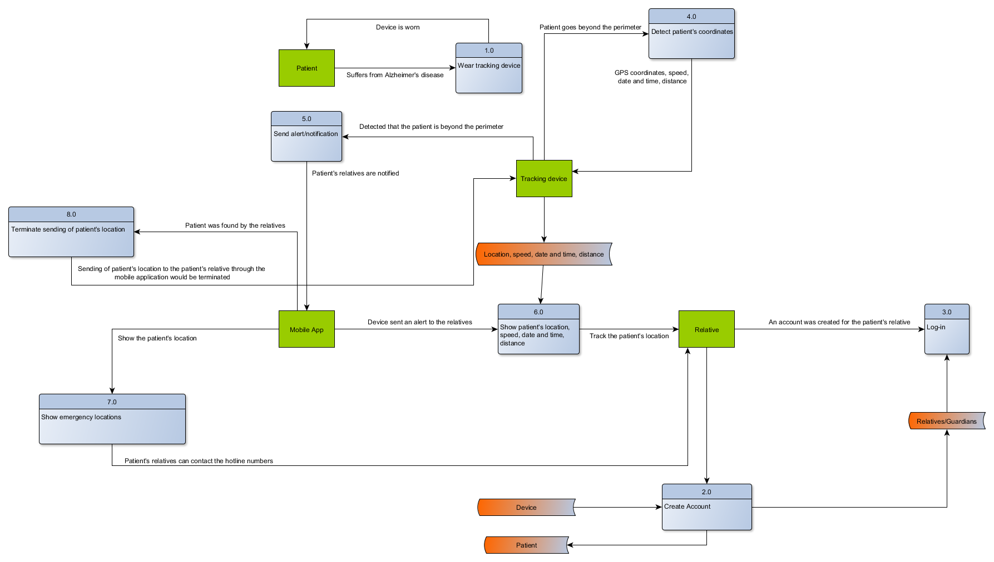
● Data Flow Diagram

Slide 12
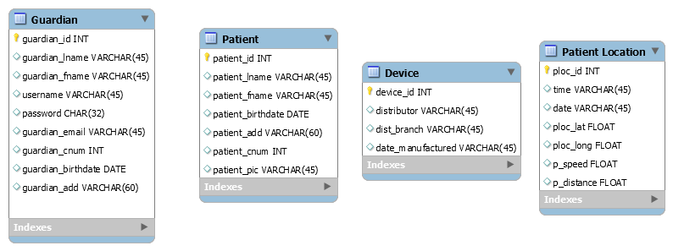
● Entity Relationship Diagram

Slide 13
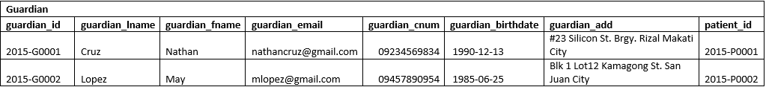


● Data Tables

Slide 14
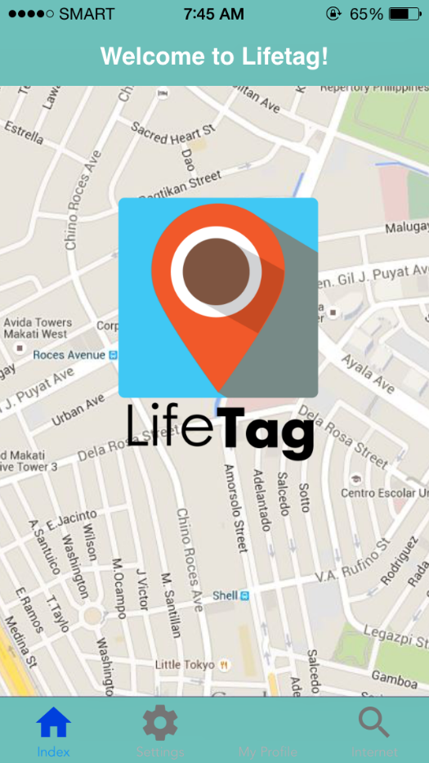
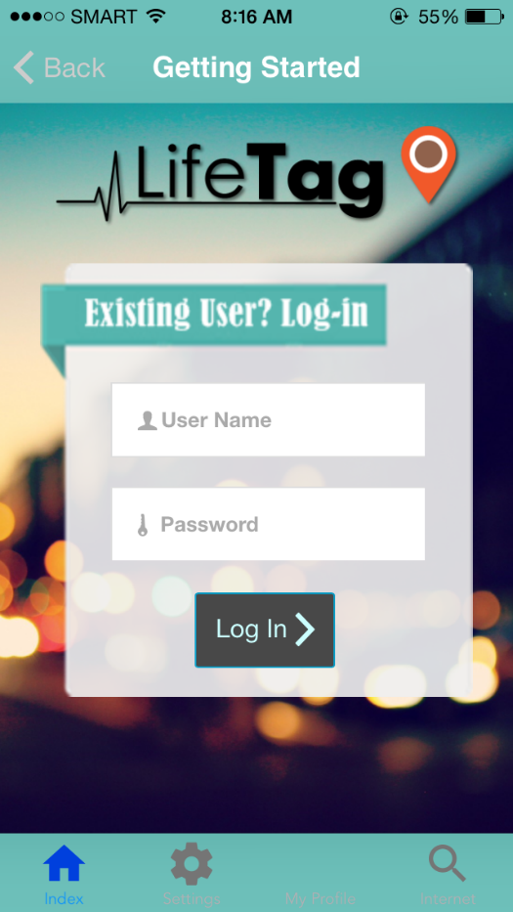
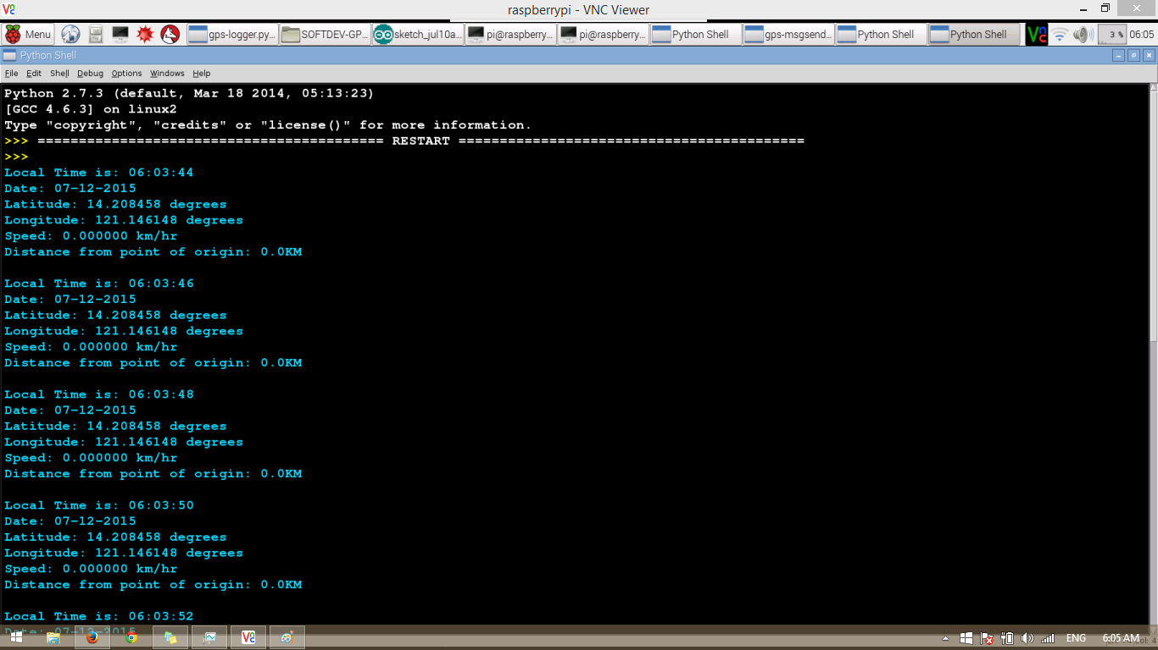
● Screenshots
MOBILE APP
RAW GPS DATA

